Slide 1

Movie Analysis
Joe, Kamryn, and Jacob

Slide 2

Summary
We analyzed movie review data given to us, so we had an idea of what a successful and not successful movie is.
Using things like budget, revenue, profit, and popularity, we determined what a good movie suggestion would be for three budgeting levels of production.

Slide 3
Outline
Business Problem
Data & Methods
Results
Conclusions

Slide 4

Business problem
Microsoft is opening a movie studio
They are not well voiced in the realm of movie production
It was our job to analyze our data and create a suggestion for which genre of movie they should make.

Slide 5
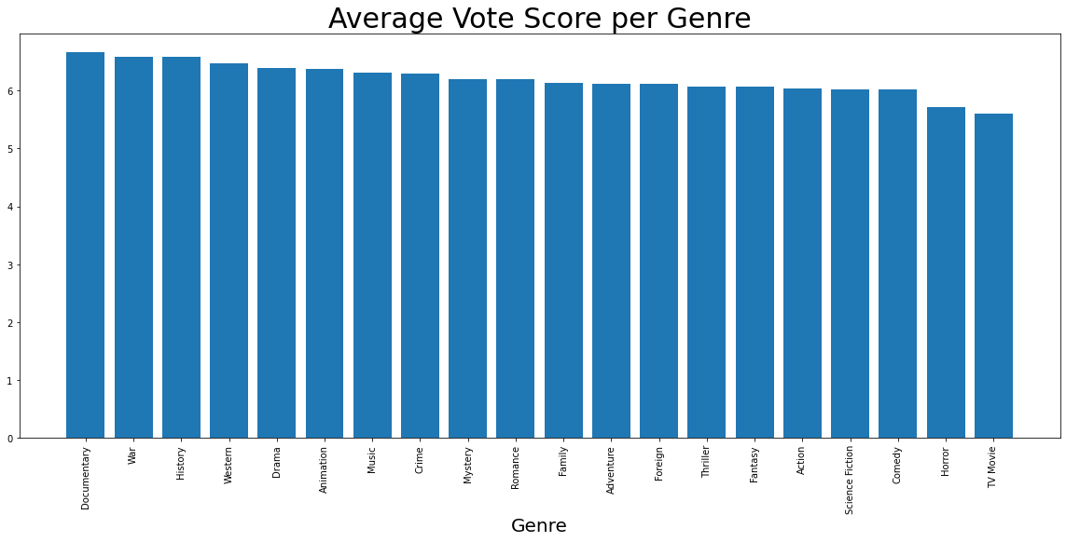
Data & methods

Slide 6
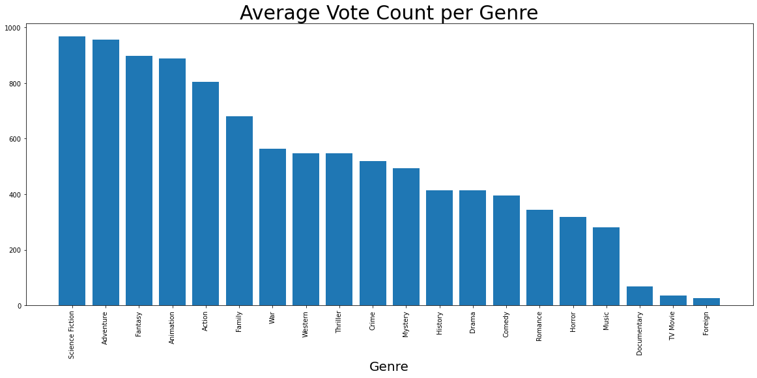
Data & Methods

Slide 7
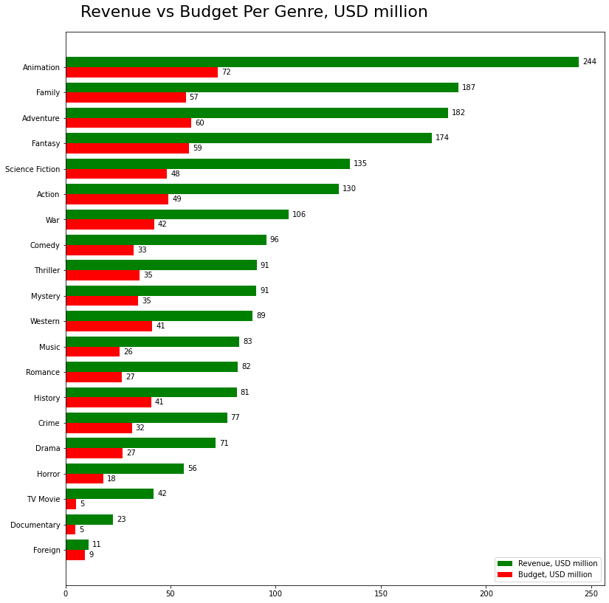
Data & Methods

Slide 8
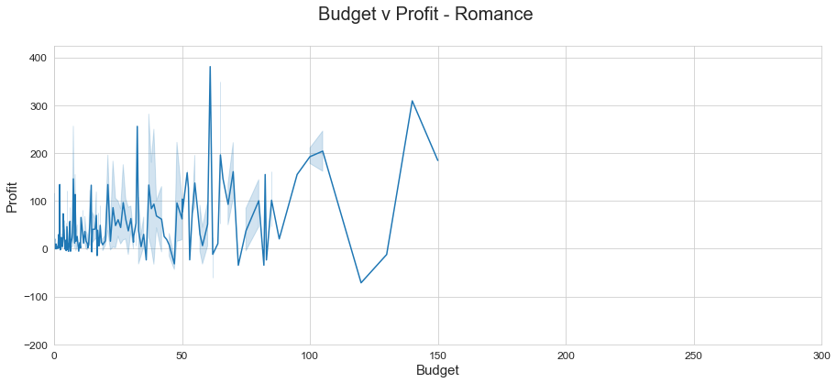
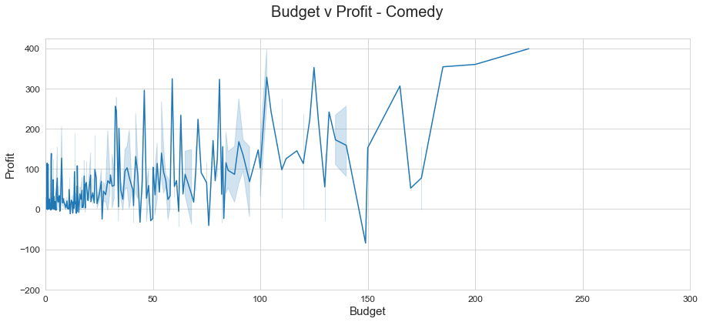
Data & methods

Slide 9
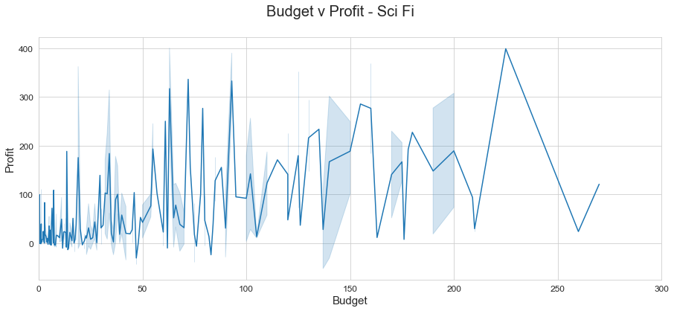
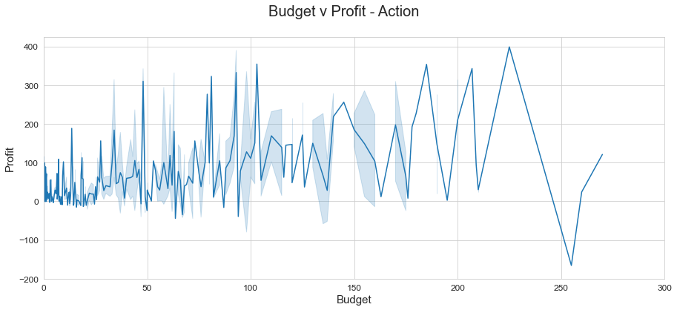
Data & methods

Slide 10
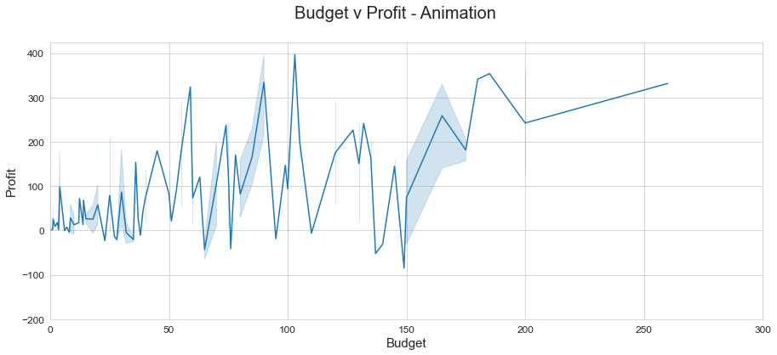
Data & methods

Slide 11
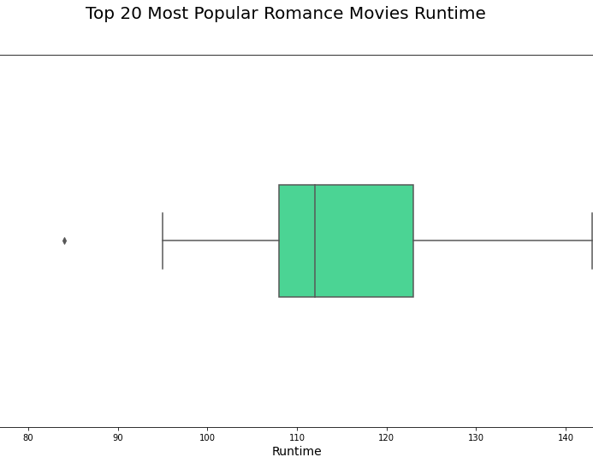
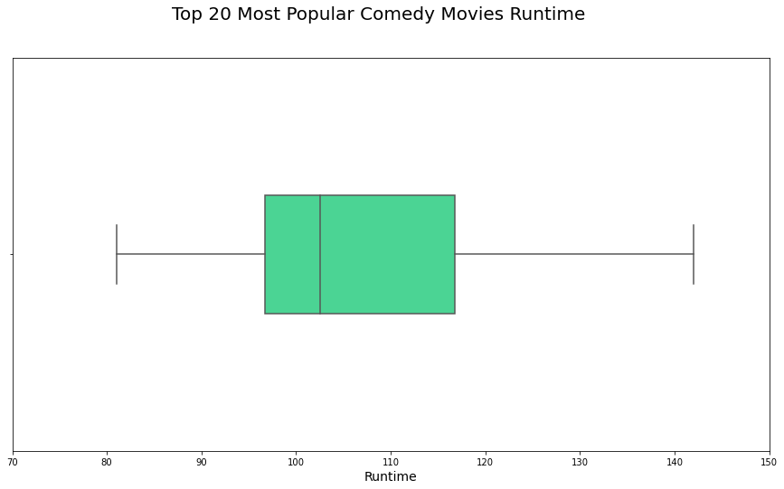
Data & Methods

Slide 12

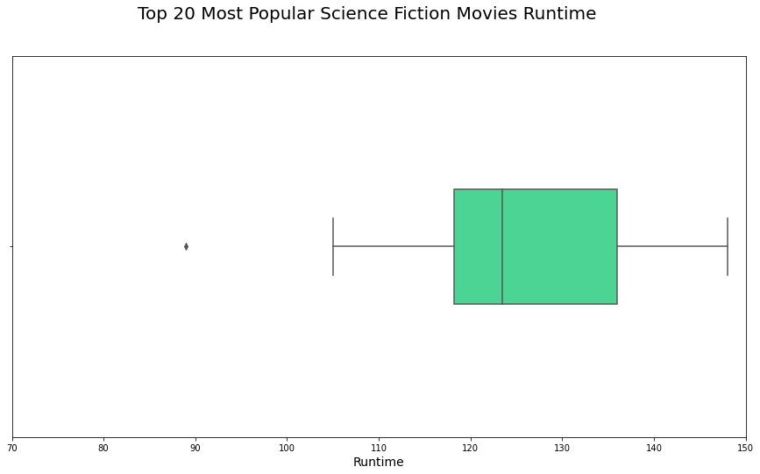
Data & Methods

Slide 13
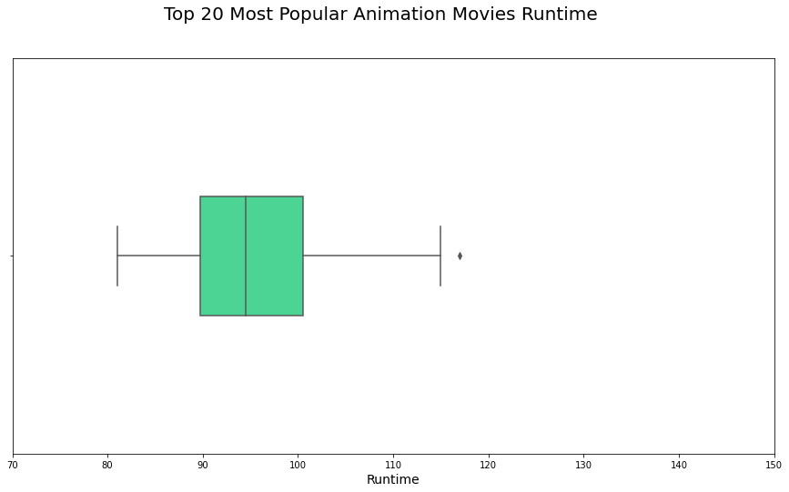
Data & Methods

Slide 14
results
Based on our data, if you want to make a lower budget movie, a romance comedy film is going to be your best bet.
For a more mid-range budget movie, an action-scifi film would be a great option.
Lastly, if you wanted a higher budget movie, animation is the direction you should take.

Slide 15
conclusions
With our suggestions, we are confident you can could produce a profitable and successful movie in your desired budget range.

